Slide 1
LINQ to External Data
IN710 OOSD 2017
Session 10.2

Slide 2
LINQ to SQL
LINQ to SQL is syntactically the same as LINQ to objects
You connect the system to an SQL database
LINQ commands are then invoked on that database instead of on collection objects

Slide 3
Combining OO and RDBMS
It is common to build an application with an OO application layer and a relational data layer.
Two approaches:
Use classes that let you connect to a database and manually write and execute SQL queries.
Use an Object Relational Mapper (ORM)
Classes first
Database first
Notes:
You have seen the first approach already in Web2 with php, in Mobile with Java. You can also do this in C#, and we will see that in a later lecture.
Wee are going to start, however, with the second approach, because that’s where we will see LINQ.
An ORM is a set of tools that allows you to write normal OO code that is automatically translated into RDBMS code. That is, you don’t write SQL, you just write C#. The ORM provides all the infrastructure to translate (map) between your classes and your tables.
Most ORMs have two options: you write the classes and the ORM creates the tables, or you write the tables and the ORM creates the classes. Both approaches have advantages and disadvantages; we will discuss as we go.
Today when we look at ORM in C# we will look at Database first. Later, when we do MVC, we will look at Classes first.

Slide 4
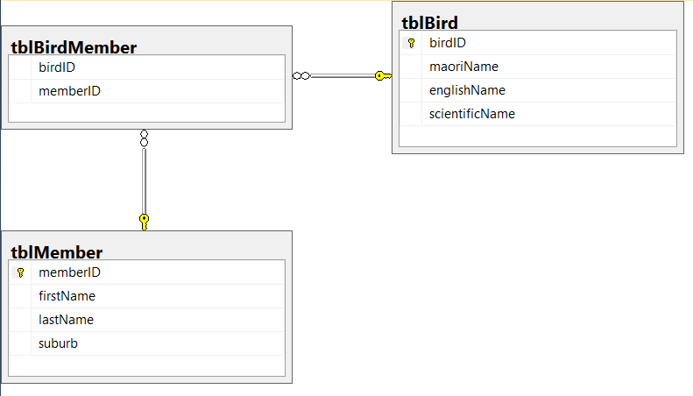
C# ORM – Database First
Notes:
Assume that you have created this database on an MSSQL server (details covered in practical, but it’s just normal SQL)
This represents a bird watchers club.
You have members of the club, birds that have been sighted, and a joining table linking members to sightings.
From a C# project, you can link directly to this database, write code to slurp the tables into Ienumerables, and use LINQ to operate on them.

Slide 5
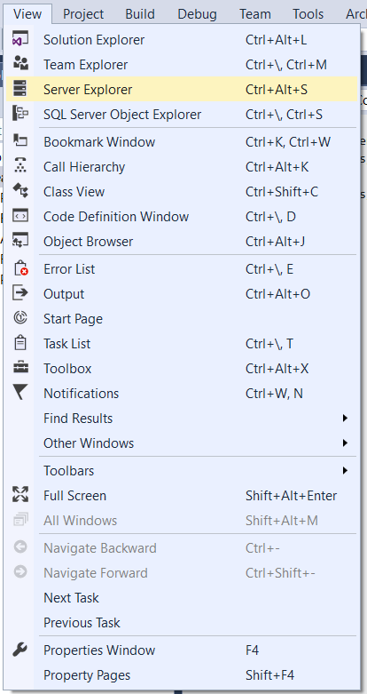
C# ORM – Database First
Connecting to an SQL database
Notes:
Use the Server Explorer

Slide 6
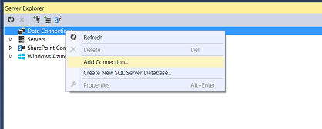
C# ORM – Database First
Notes:
Right-click on Data Connections and select Add Connection

Slide 7
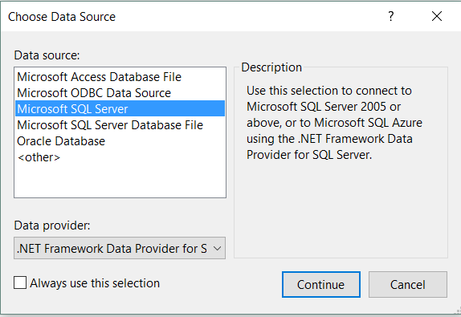
C# ORM – Database First
Notes:
Make the appropriate choice.
We will be using Microsoft SQL Server

Slide 8
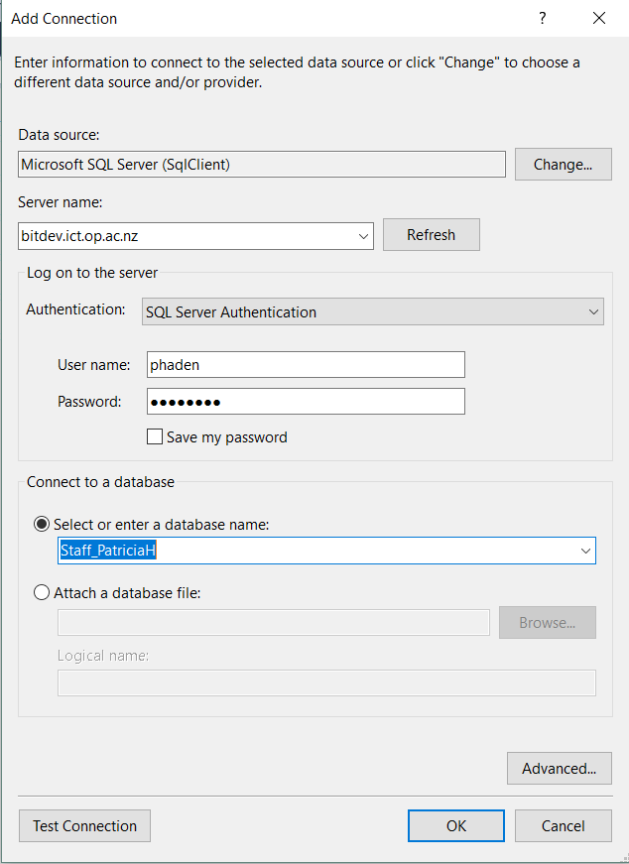
C# ORM – Database First
Notes:
Windows Authentication for local SQL Express
SQL Server Authentication for bitdev; use the login information you received from Rob.
Can have multiple connections open at the same time in a single project
DO NOT click Refresh. It takes forever.
You will see the databases you have access rights to in the Connect to a database drop down

Slide 9
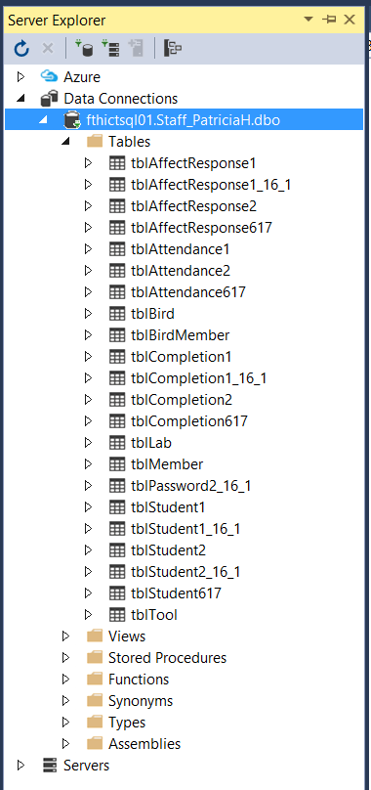
C# ORM – Database First
Notes:
The connection and information about it appears in the Server Explorer
(The extra tables are from a different project. The way bitdev is set up, you get one database and all tables from everything you’re doing have to go in it. This isn’t a problem from the programming perspective.)

Slide 10
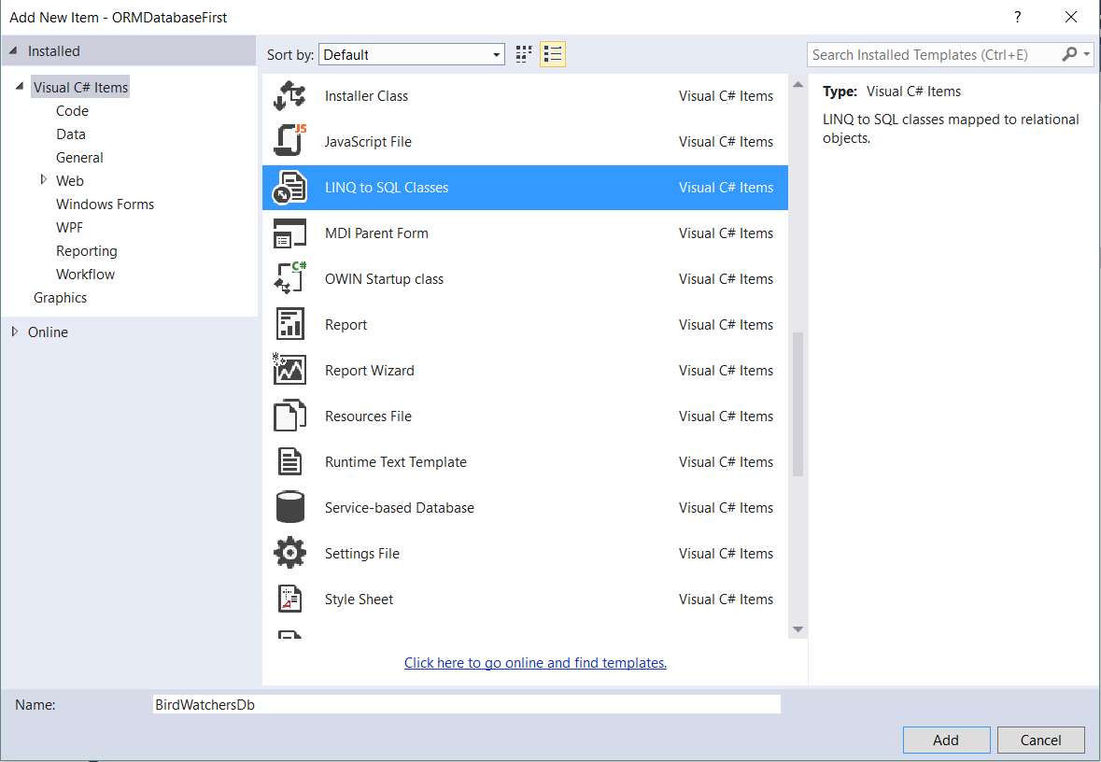
C# ORM – Database First
Notes:
Add a New Item to your project, a “LINQ to SQL Classes” item
Name it carefully.
The system creates a new class type based on that name
The name here is BirdWatchersDb

Slide 11
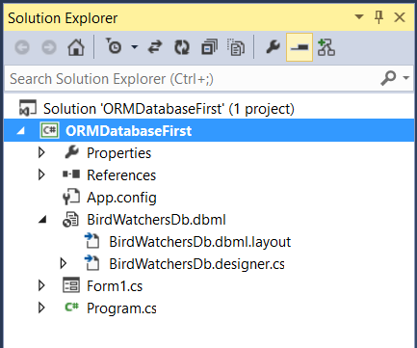
C# ORM – Database First
Notes:
In the Solution Explorer you will now see a new dbml object, here called BirdWatchersDb.dbml
Double click on it to bring up the database designer

Slide 12
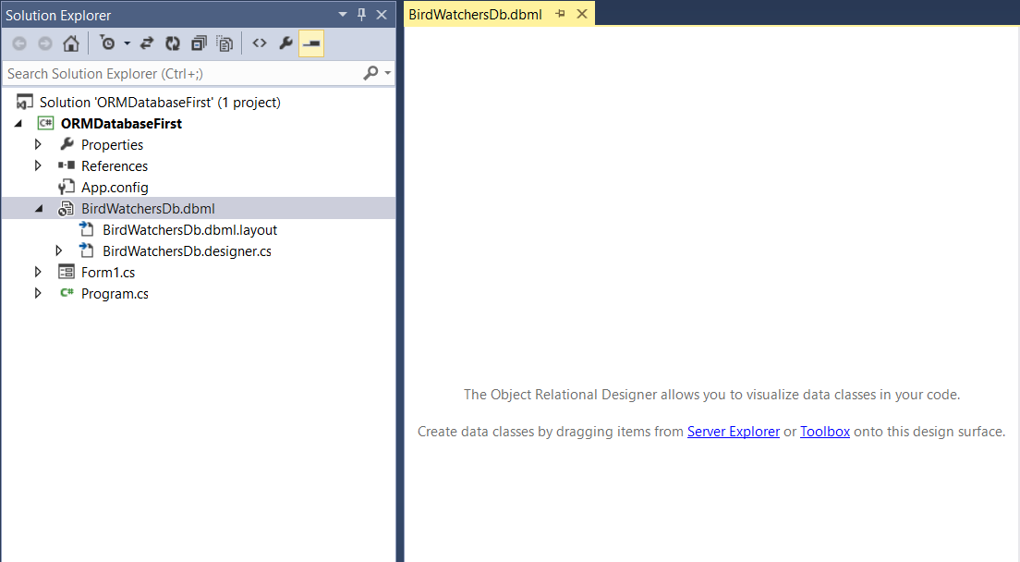
C# ORM – Database First
Notes:
You will drag the tables you want from the database connection onto this surface…
Expand the database connection in the Server Explorer and pull over what you want

Slide 13
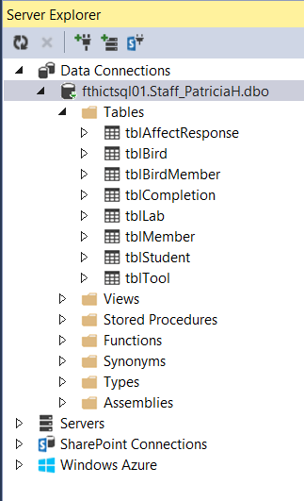
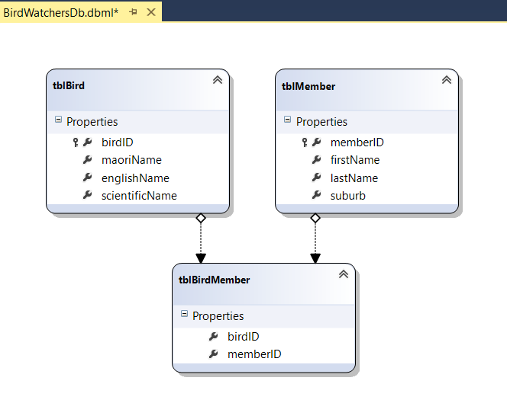
C# ORM – Database First
Notes:
We’re using here a database created with ORM in the other direction; that’s what the EdmMetadata is for.
We only want the real tables, though.
We drag and drop the ones we want…
The system will now create classes to represent this database, including the relationships.

Slide 14
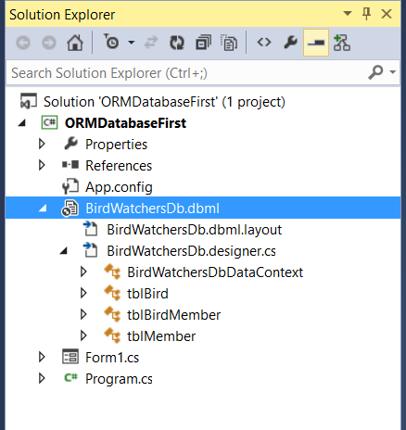
C# ORM – Database First
Notes:
You can see in the Solution Explorer, that the system has created some classes for you in the dbml entity’s .cs file.
There’s a lot of code in there as well.
Double-click to open it...

Slide 15
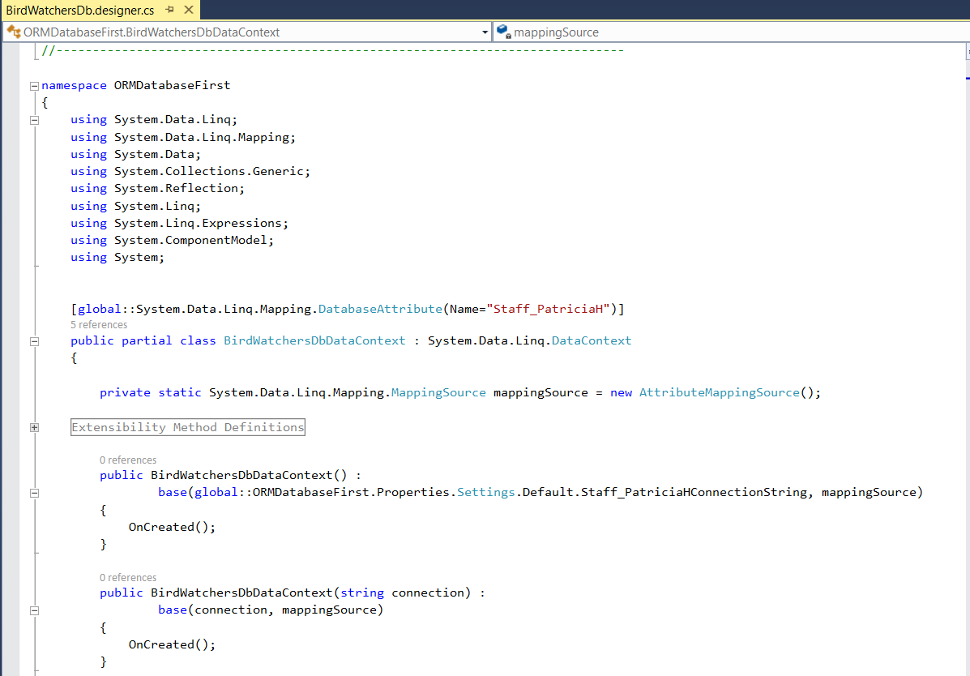
C# ORM – Database First
Notes:
This guy, BirdWatchersDbDataContext, descended from System.Data.Linq.DataContext is the class that will implement the data stream between the SQL database and your program.
Look through the code to see lots of methods for working with the classes inferred from the tables in your database.
This is system generated code that you should not modify (there’s a warning up above that we can’t see in this slide).
You need to create an instance of the DataContext class.
It will hold all the data from the tables you have dragged in
Effectively, .NET creates the classes you would have built had you implemented the whole thing in memory as we did last time with the pets and the artists and so on.
These are called entity classes; the ORM is called Entity Framework.
From here, it’s just like last week except that instead of talking to an array or list you have created, you talk to one of the database tables, as represented now by a collection held in the DataContext instance.
Let’s look at some examples...

Slide 16
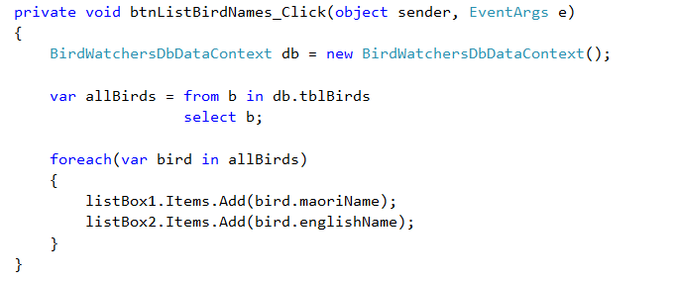
LINQ to SQL
Notes:
We make the data context db, and access the birds table by name as shown.

Slide 17
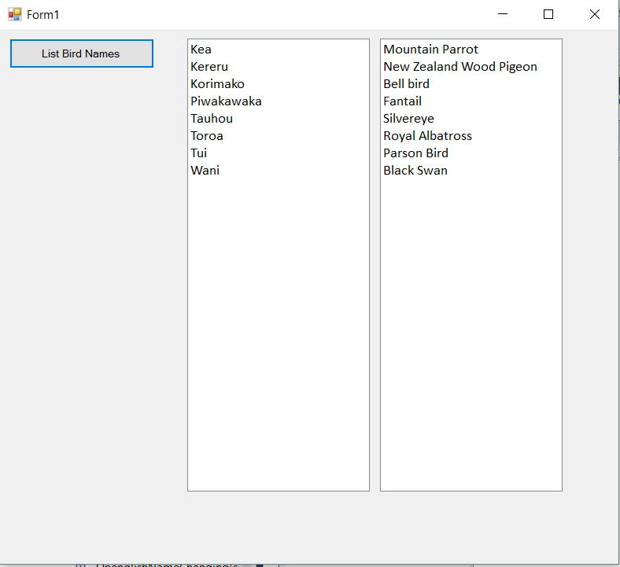
LINQ to SQL

Slide 18
LINQ to XML
Notes:
As we have seen, XML representations impose a hierarchical (tree) structure on a data context to describe the elements, attribute and relationships of the context.
We can also use the LINQ extension methods and query operators on XDocument objects.
Left as an exercise.
We want to look now at the LINQ to SQL practical...

Slide 19
Practical Preparation
Using SQL Server Management Studio (SSMS)
Notes:
In addition to giving you a chance to practice LINQ to SQL, this practical will let you work with MSSQL and SSMS, and make sure that your bitdev accounts are in order.
You will probably want to use bitdev for the second assignment, and this will catch any problems.
Walk through logging on and executing queries

Slide 20
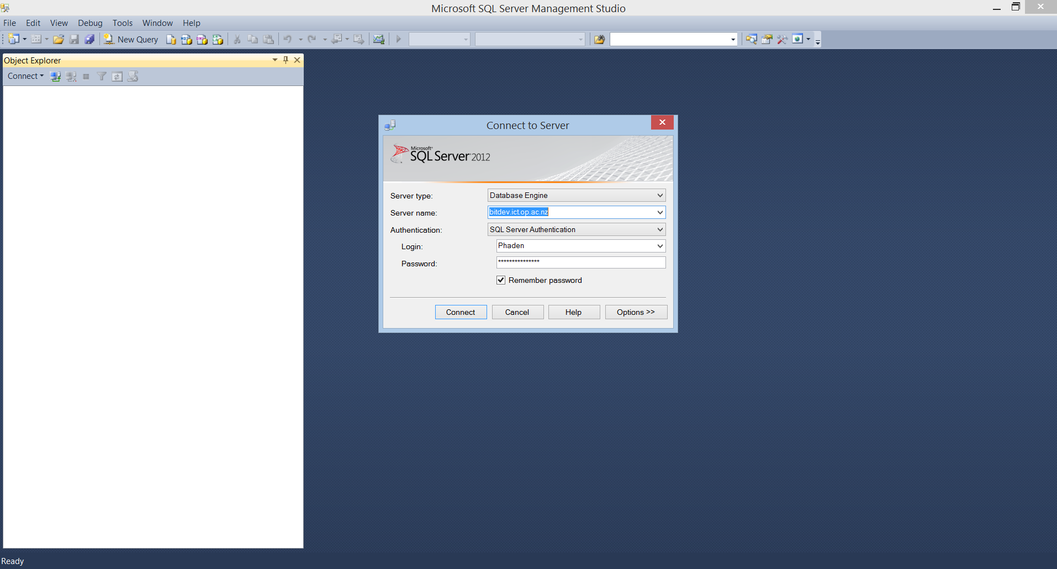
SSMS
SQL Server Management Studio
Notes:
When we make our connection string and use our SQLCommand objects, we are working with a real SQL Server database, over on bitdev.
During development, it is often useful to be able to look directly at the database on the machine
This is a useful way to find bugs.
The tool that lets you do this is SSMS
It is installed on all student machines.
You log into it and you can navigate directly to your own database and look at your tables.
Find it in the program files and start it.
You’ll see this.

Slide 21
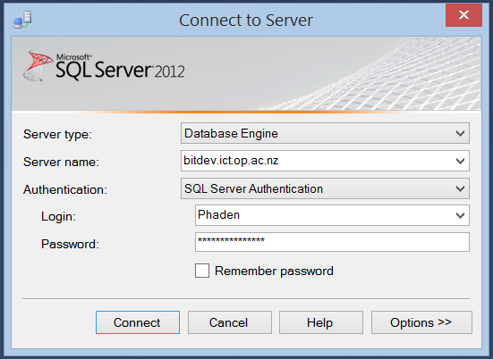
Log in to SSMS
Notes:
When we make our connection string and use our SQLCommand objects, we are working with a real SQL Server database, over on bitdev.
During development, it is often useful to be able to look directly at the database on the machine
This is a useful way to find bugs.
The tool that lets you do this is SSMS
It is installed on all student machines.
You log into it and you can navigate directly to your own database and look at your tables.
Find it in the program files and start it.
You’ll see this.
Log in using the information Perrin has sent you.
By the way, that Server Name drop down has a “Browse” option. Don’t select it, you will be there all day while SSMS looks all over the world for servers. Just type bitdev in as shown.
SQL Server Auth is required

Slide 22
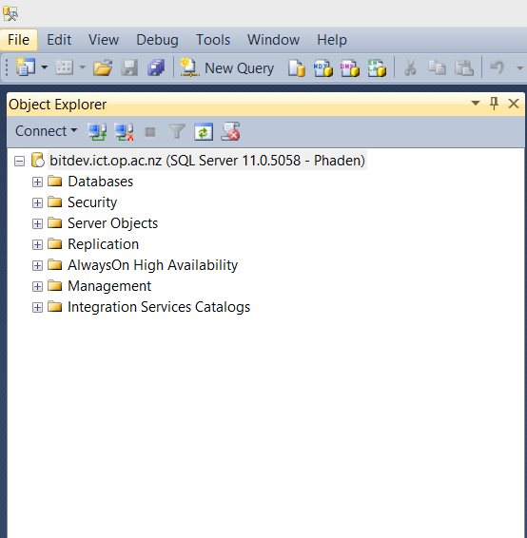
SSMS Object Explorer
Notes:
You should see this, with your name, of course.
Open the Databases folder by clicking on the little plus sign...

Slide 23
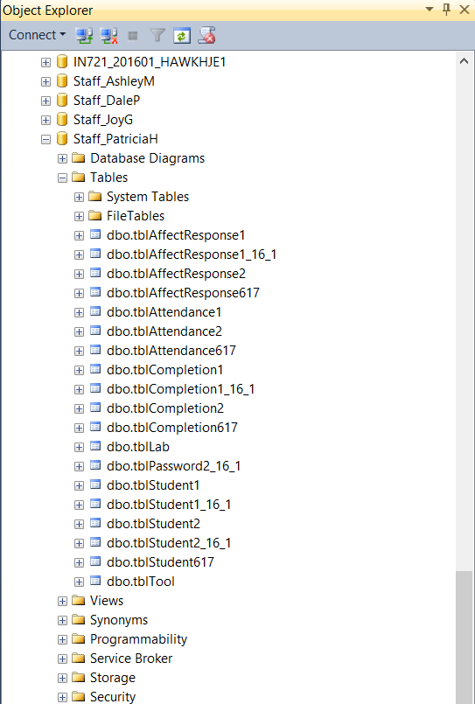
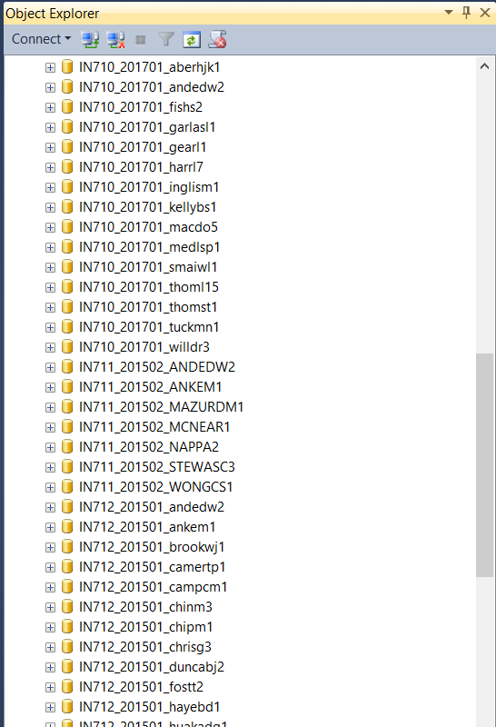
Find Your Database
Notes:
Because of security restrictions, YOU ARE NOT ALLOWED TO CREATE DATABASES.
You have one database and you can create tables in it.
All your db work for the semester will go in that database and you will end up with a big jumble of tables if you don’t keep it tidy.
Not perfect, but also not negotiable, according to every sysadmin ever.
Open your database...
Open your Tables

Slide 24
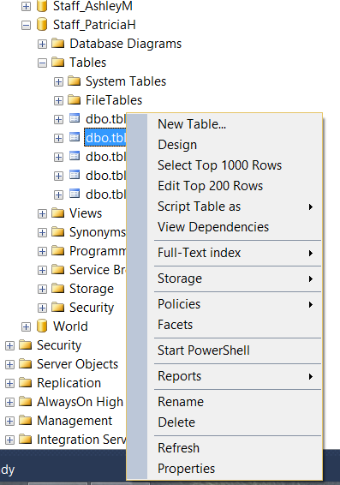
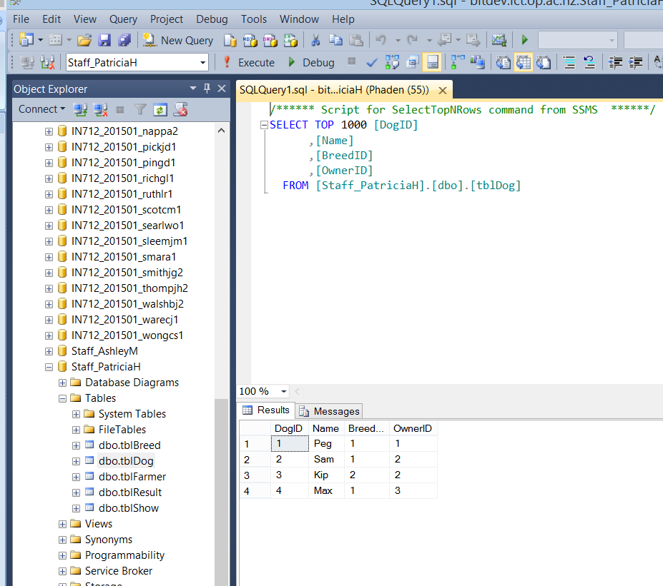
Browse Your Tables
Notes:
Once you’re into your database you can query the tables directly
Right-click on any table and have these choices.
Select one and....
If you prefer to write your own SQL, just type it in that upper pane and click the !Execute button (not the green triangle debug button)
We will be doing a lot of database stuff between now and the end of the semester, so it is worth investing some time in learning to use SSMS.

Slide 25
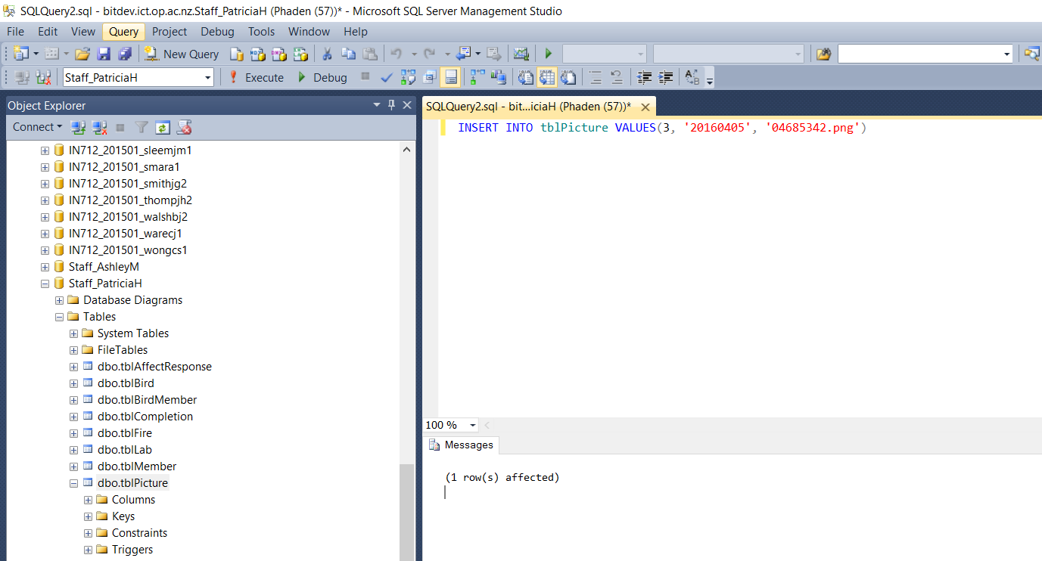
Performing Queries
Notes:
To perform a query...
Click New Query. This opens a tab
Type in your SQL. The dialect is T-SQL; lots of references available.
Click Execute. NOT THE GREEN TRIANGLE, that is debug and you don’t have debug privileges.
Feedback appears here. Error message or # rows affected, etc.

Slide 26
Practical

